Slide 1
An NLP-driven study on social media sentiment trends
Prepared by: Filda Kiarie School: Moringa School Email: filda.kiarie@student.moringaschool.com
Twitter Sentiment Analysis: Apple vs. Google

Slide 2
Project Overview
Objective:
Classify tweets about Apple and Google as positive, negative, or neutral using NLP
Dataset: CrowdFlower Twitter dataset (~9,000 tweets).
Dataset Source: data world
Approach:
Data preprocessing
Feature engineering
Model development Evaluation
Interpretation.

Slide 3
Data Preprocessing
Text Cleaning:
Lowercasing
Removing punctuation & special characters
Stopword filtering
Feature Engineering:
TF-IDF vectorization
Tokenization

Slide 4
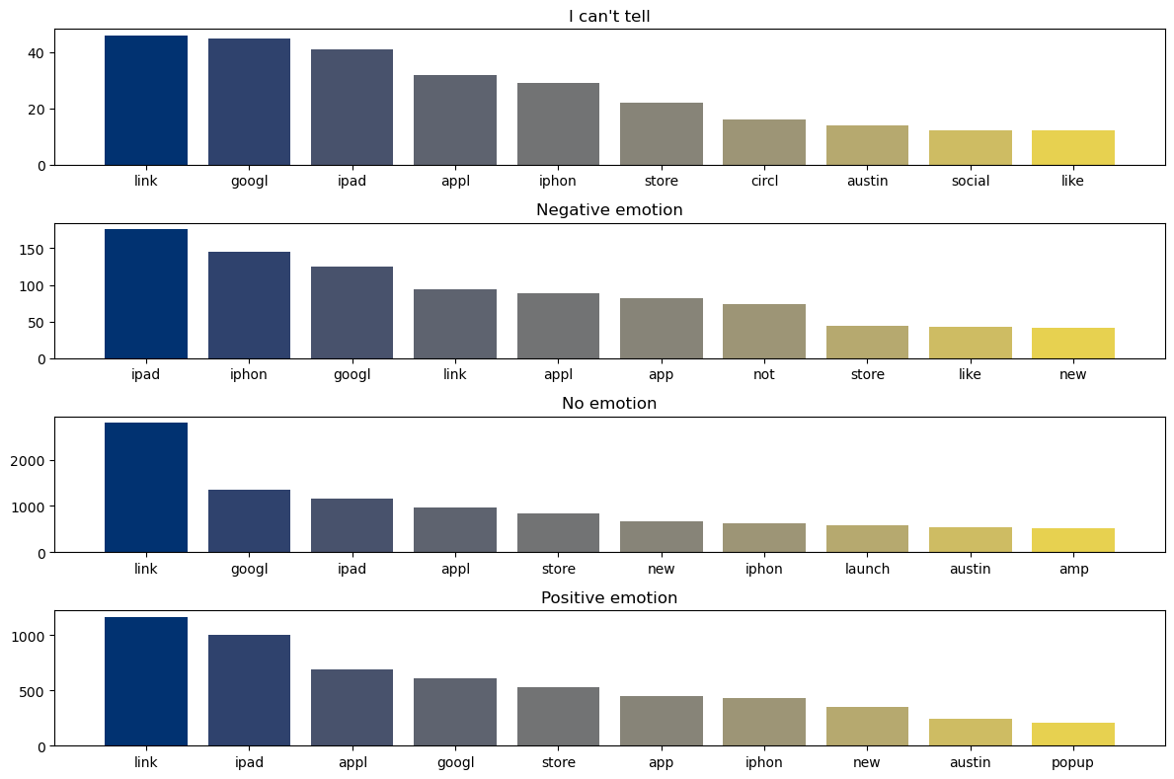
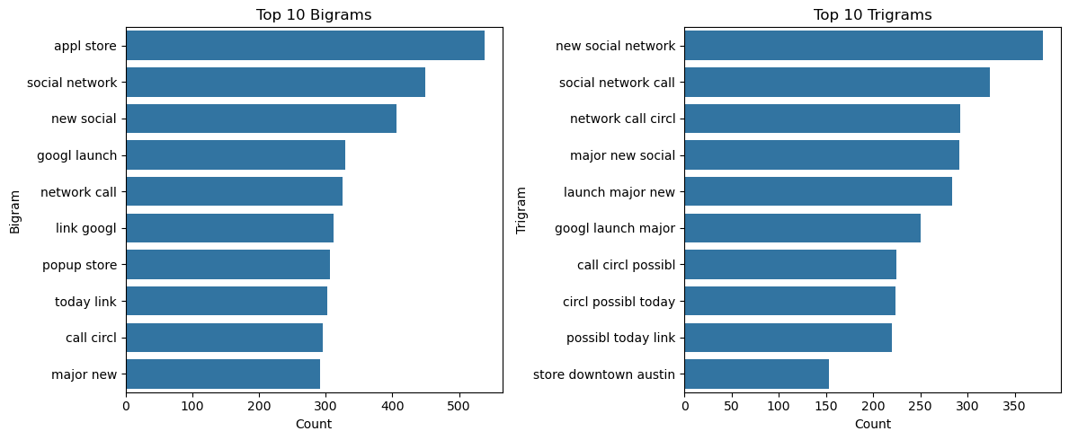
Frequent Words
Bigrams & Trigrams:
This chart showcases the most frequent word combinations, helping identify popular phrases and trends.
Data Exploration
This visual highlights the most commonly used words in the dataset, giving insight into key topics of discussion.

Slide 5
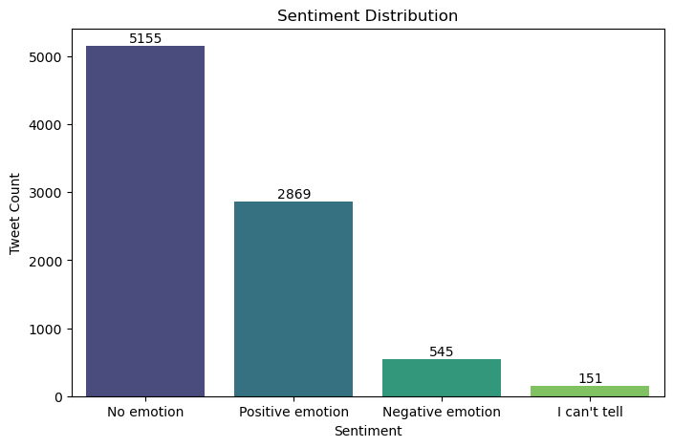
Sentiment Distribution
Objective: Categorizing tweets into positive, negative, and neutral sentiments.
Sentiment Distribution Chart:
This visualization displays the proportion of tweets classified as positive, negative, or neutral.
Key Takeaways:
Provides an overview of public perception.
Useful for understanding sentiment trends for Apple vs. Google.

Slide 6
Model Selection
Logistic Regression
Support Vector Machine (SVM)
XGBoost
Evaluated using accuracy, precision, recall, F1-score, and SHAP analysis.

Slide 7
Model Performance Summary
Model | Accuracy | Precision | Recall | F-score
Logistic Regression | 96% | High | High | High
SVM(Best) | 98% | Best | Best | Best
XGBoost | 92% | Moderate | Moderate | Moderate
Key Takeaways:
SVM outperformed all models with the highest accuracy and balanced classification.
Logistic Regression remains valuable for interpretability.
XGBoost was slightly weaker but still useful.

Slide 8
SHAP Interpretability:

Slide 9
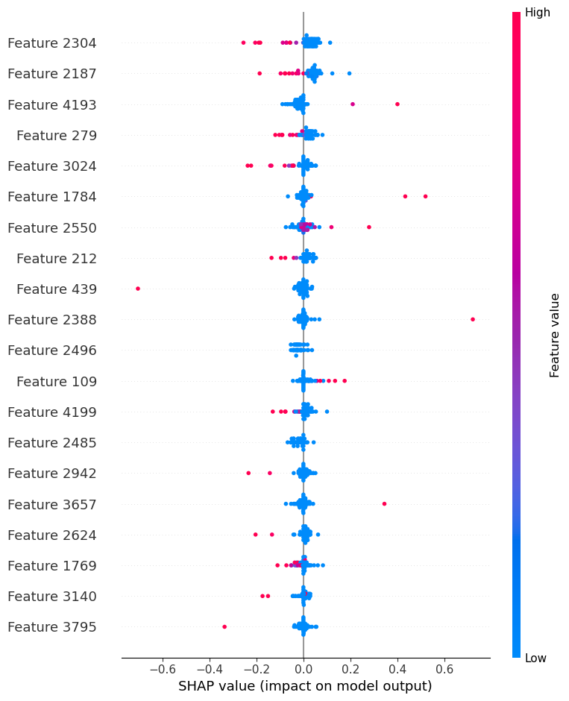
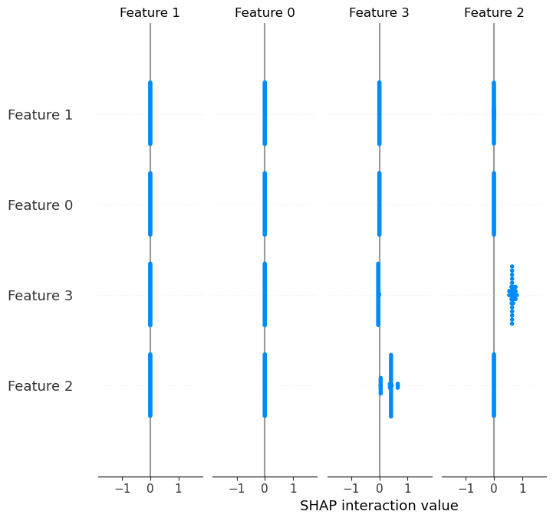
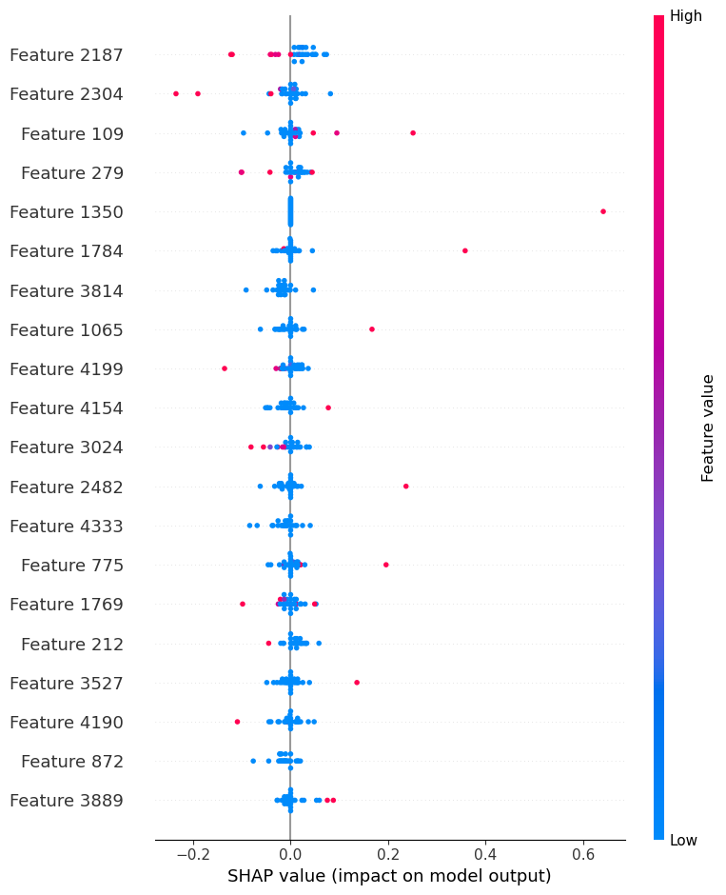
Logistic Regression SHAP Output: Identified key words contributing to sentiment classification.
XGBoost SHAP Output: Highlighted word influence but with more variance.
SVM SHAP Output: Confirmed strong feature importance consistency.
Conclusion: SVM consistently had more reliable feature explanations for decision-making.

Slide 10
Key Insights
SVM is the most accurate model (98%) and balances all sentiment classes effectively.
Logistic Regression (96%) offers strong interpretability for tracking sentiment trends.
XGBoost (92%) struggled slightly with class imbalances but remains a useful alternative.
Misclassification was highest between neutral and negative sentiment classes.

Slide 11
THANKS!
Do you have any questions?
filda.kiarie@student.moringaschool.com
Git Username: FildaKim

